Slide 1
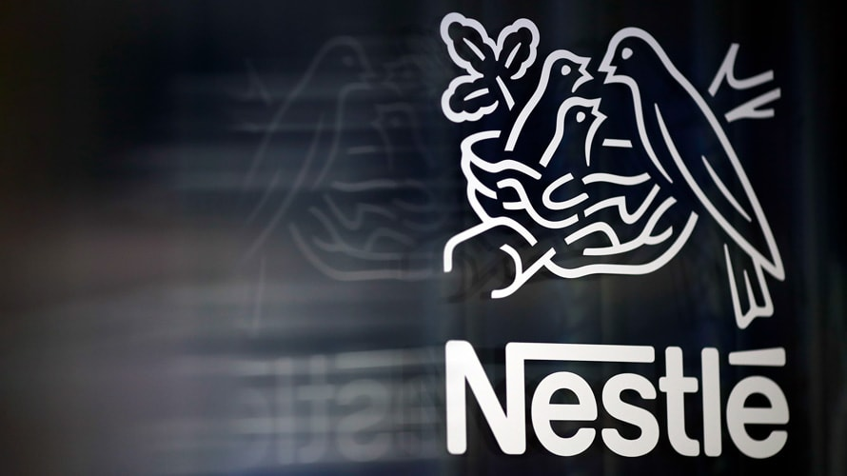
NESTLE SALES DASHBOARD
ONIDOMA MATTHIAS

Slide 2
INTRODUCTION
Nestle as the largest food company in the World, marketing over 8,500 brands and 30,000 products. The Company wants to expand its business by adding new product lines, however they discovered that it is important to know the performance of the current products.
As a Data Analyst in the Growth and Strategy Department of Nestle, the following are the insights generated from the Company’s data from 2018-2020, to drive business growth.

Slide 3
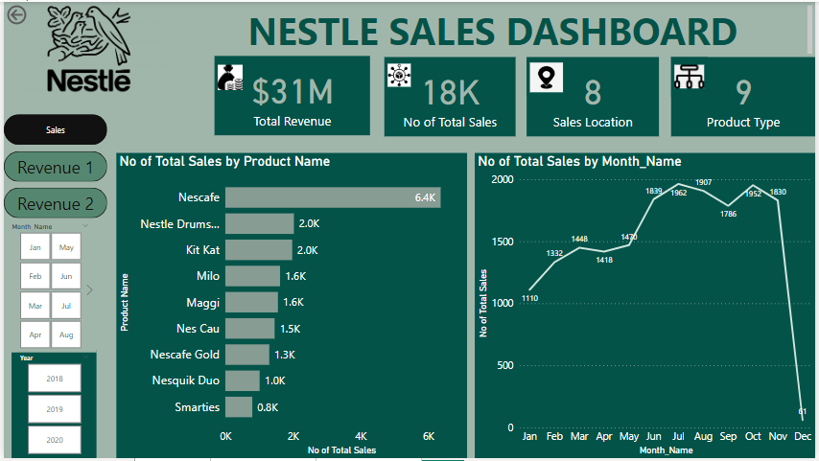

Slide 4
INSIGHTS
Nestle’s Products made $31M from selling 18,000 units of 9 Products, using 2 Sales medium (Direct and Online).
Total Sales by Product Name:
Nescafe was the highest product sold with about 6400 units between 2018-2020, while Smarties was the least product sold within the same period(800 units). Further breakdown of the highest and least products shows that:
In 2018: 1972 units (Maximum) of Nescafe was sold while 330 units (Minimum) of Smarties was sold.
2019: 2133 units (Max) of Nescafe and 232 units (Min) of Smarties was sold.
2020: 2263 units (Max) of Nescafe and 209 units (Min) of Nes Cau was sold.

Slide 5
INSIGHTS
Total Sales by Month:
July recorded the highest sales with about 1,962 units (2018-2020), while December recorded the least sales within the same period(61 units). Further breakdown of the highest and least sales shows that:
In 2018: October had the highest sales (672 units) while December was the lowest(21 units) .
2019: July recorded the highest sales (672 units) while December was the lowest(20 units)
2020: July and October recorded the highest sales (640 units) while December was the lowest(20 units)

Slide 6
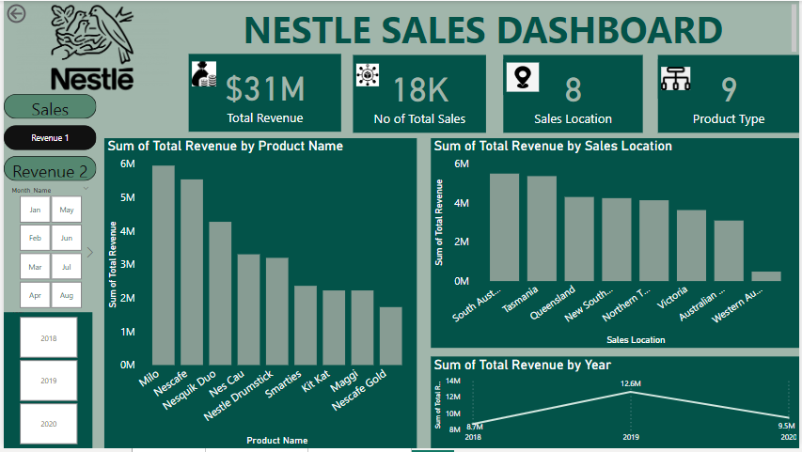

Slide 7
INSIGHTS
Revenue by Product Name:
From 2018-2020, Milo generated the maximum revenue($6M) while Nescafe Gold was minimum($1.7M) . Further breakdown of the highest and least sales shows that:
In 2018: Nescafe generated the highest revenue ($1.63M) while Nescafe Gold had the lowest ($0.50M) .
2019: Nescafe generated the highest revenue ($2.06M) while Smarties had the lowest ($0.67M)
2020: Milo generated the highest revenue ($2.40M) while Nes Cau had the lowest ($0.17M)

Slide 8
INSIGHTS
Revenue by Year:
2018: $8.7M
2019: $12.6M
2020: $9.5M

Slide 9
INSIGHTS
Revenue by Sales Location:
2018: Maximum revenue was generated in Tasmania($1.61M) while the minimum was generated in Western Australia ($0.10M)
Maximum revenue was generated in South Australia ($2.36M) while the minimum was generated in Western Australia ($0.19M)
Maximum revenue was generated in Tasmania ($1.62M) while the minimum was generated in Western Australia ($0.20M)

Slide 10
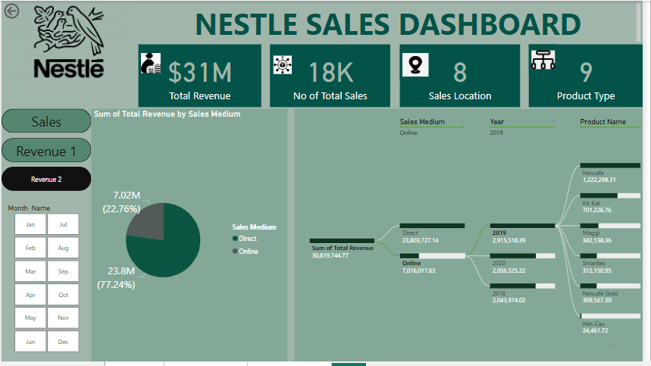

Slide 11
INSIGHTS
Revenue by Sales Location:
Direct Medium:
2018 = $6.67M
2019 = $9.71M
2020 = $7.43M
Online Medium :
2018 = $2.04M
2019 = $2.92M
2020 = $2.06M

Slide 12
RECOMMENDATION
The Management should utilize popular months like July and October to introduce new product lines.
Identify why Nescafe Gold, Smarties, Nesquik Duo and Nes Cau generated very low revenue and recorded poor sales, with the findings Nestle Management should ensure they improve these products or introduce new products with similar description.
Online services should be made seamless to enhance revenue boost and customer patronage.
While I recommend a proper awareness of Nestle products in Western Australia, a thorough investigation should be done to ascertain the cause of concurrent poor sales and low revenue within this Region.

Slide 13
RECOMMENDATION
The Organization should ensure that the raw materials needed for the production of Nescafe and Milo are readily available as their demand is very high over time.
Perishable resources used in production should be drastically reduced in the month of December to avoid wastage, since December recorded poor sales and low revenue for the period under review, however an extensive study of the happenings in December should be done.
I would like to do further analysis on the number of branches in each location or region, to help boost the quality of my analysis and to determine if more branches should be created in high revenue locations.

